Slide 1
GRU
Inference and implementation

Slide 2
Why to use GRU??
-RNNs often struggle with short-term memory issues, particularly due to the vanishing gradient problem.
-To address this, LSTMs and GRUs are employed as they are designed to effectively retain long-term dependencies in sequential data
-LSTMs have numerous parameters that require updating during backpropagation.
-The large number of parameters makes LSTMs computationally expensive.
-GRUs are a more recent innovation, introduced in 2014.
They serve as a lightweight alternative to LSTMs, offering similar functionality with fewer parameters.

Slide 3
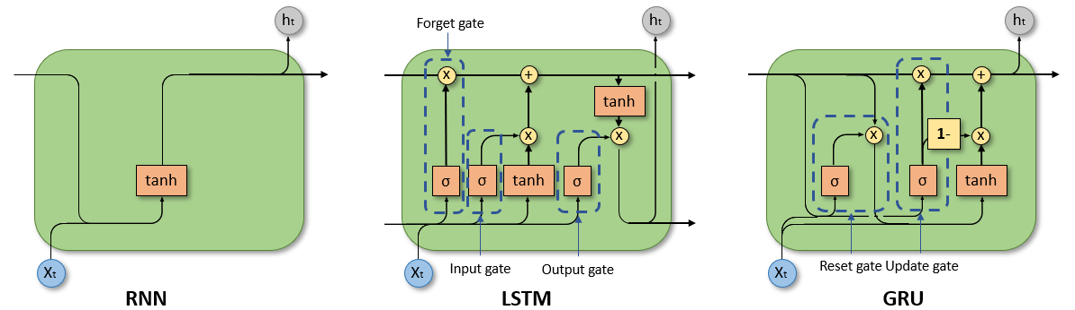

Slide 4
Inference
- GRUs have only two gates: the update gate and the reset gate.
- The update gate determines how much of the past memory should be retained.
- The reset gate controls how much of the past memory should be forgotten.
- Additionally, GRUs include a candidate component, which represents the new information to be added to the previous hidden state.
-The reset gate acts as a control gate for the previous hidden state, h(t−1).
-The update gate manages the information flow by:
a)Determining which information from the candidate state should be passed through.
b)Deciding how much information from the previous hidden state should be retained.

Slide 5
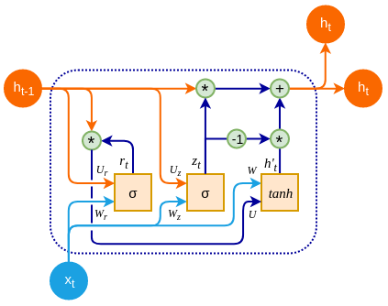

Slide 6
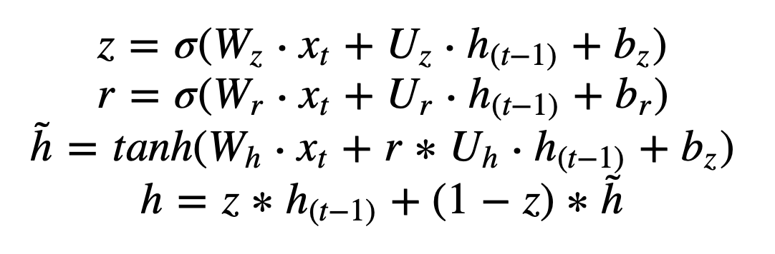
Forward pass

Slide 7
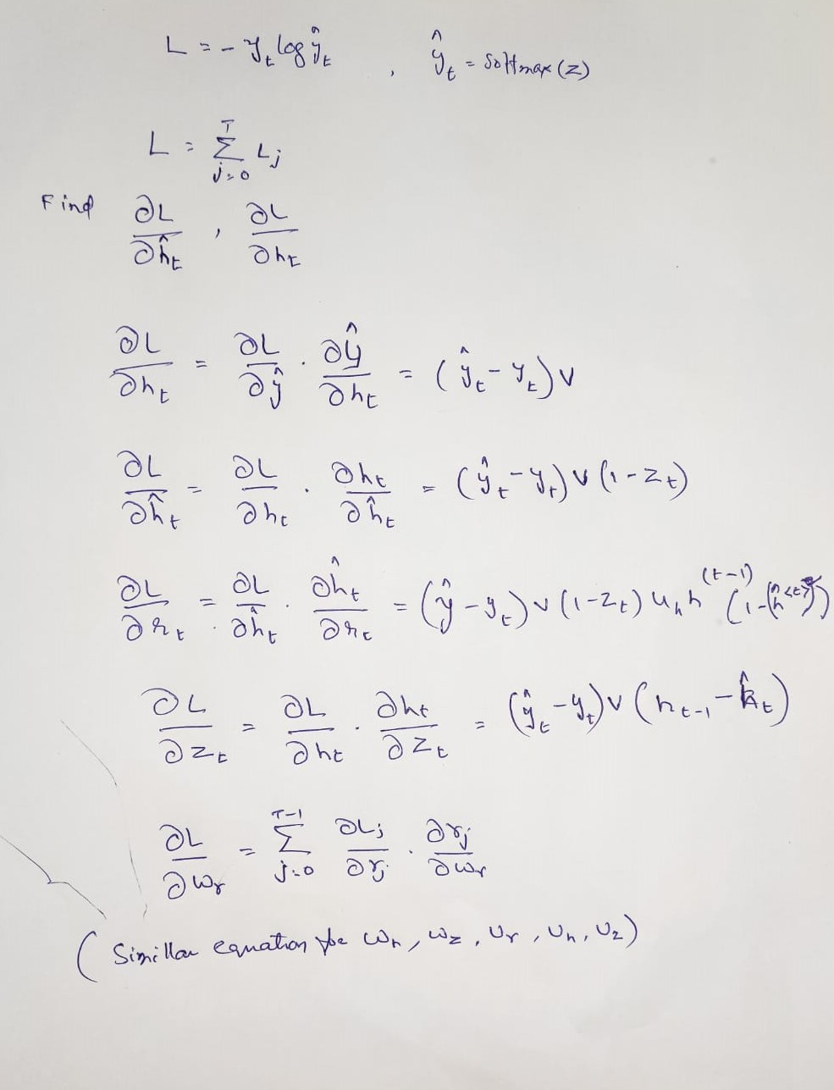
Backpropagation

Slide 8
Few Details
-If the update gate vector Z=[1,1,1,…], it indicates that all information is retained from the previous state.
-The dimensions of the GRU parameters are as follows:
R, z, h, and b have dimensions equal to the size of the hidden layer.
U has dimensions of hidden_size×hidden_size
W has dimensions of hidden_size×input_size
-Dimensions of output depends on the problem statement. If it is NER , it has a softmax layer.
If it is auto-complete task, It has vocabulary size

Slide 9
Variations of GRU
1. Default GRU (v3):
- The reset gate is applied to the hidden state before matrix multiplication.
- This is the updated or "v3" version
2. Original GRU:
- The matrix multiplication is done first, followed by the application of the reset gate.
- This version is compatible with CuDNNGRU, which is optimized for GPU usage.
CuDNNGRU is not a separate variation but rather an optimized implementation of the original GRU for GPUs.

Slide 10
Comparison with LSTM
-Energy Efficiency
-GRUs are particularly sensitive to sparse weight initialization.
-The gating mechanisms in GRUs tend to avoid the saturation problems that can occur in LSTMs.
– Better Suited for Unaligned Sequences. Eg. medical data
-GRUs inherently bias towards recent inputs, as they update their states with a more aggressive forgetting mechanism compared to LSTMs.This makes them particularly effective in tasks where recent context is more important than long-term dependencies.
- In autoencoder structures, GRUs have shown unexpected strengths in tasks involving sequence compression and reconstruction.

Slide 11
Task-2
-User has to input:
Number of sequences: Total number of sequences in the input data.
Number of time frames per sequence: Number of words in each sequence.
Size of input xt​: Corresponds to the dimensionality of the input vector at each time step.
Size of hidden layer ht​: Corresponds to the dimensionality of the hidden state vector at each time step.
All Sequences: sentences

Slide 12
-Run this program to get Pre-Trained files
- Download the folder containing the text files with the pre-trained weights.
-Load these files into your C program and execute the forward pass function.

